Slide 1
Flows in networks

Slide 2
Shipping oil
We have a network of pipelines along which oil can be sent. The goal is to ship as much oil as possible from the source s and the sink t.
Each pipeline has a maximum capacity it can handle, and there are no opportunities for storing oil en route(在运输过程中，不能储存).

Slide 3
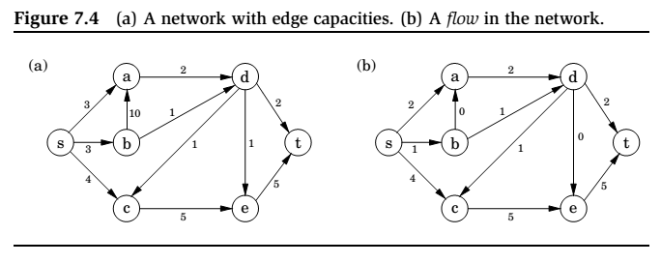
A Flow in Network

Slide 4
Maximizing flow
The networks consist of a directed graph有向图 G = (V , E ); two special nodes s, t ∈ V , which are, respectively, a source and sink of G ; and capacities ce > 0 on the edges.
We would like to send as much oil as possible from s to t without exceeding the capacities of any of the edges.
A particular shipping scheme is called a flow and consists of a variable fe for each edge e of the network, satisfying the following two properties:
1. It doesn’t violate(超过) edge capacities: 0 ≤ fe ≤ ce for all e ∈ E .
2. For all nodes u except s and t, the amount of folw entering u equals the amount leaving
其它节点的出等于入
(w,u )∈E
fwu = fuz
(u,z )∈E
In other words, flow is conserved.守恒的

Slide 5
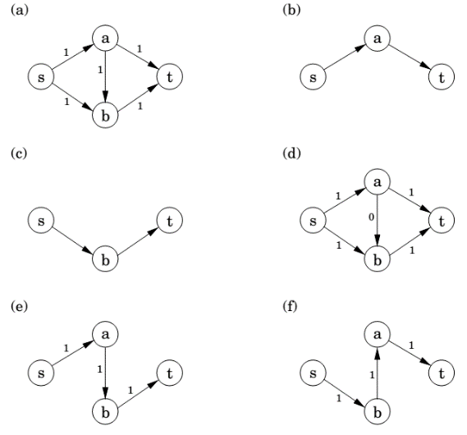
Max-flow algorithm: example

Slide 6
Maximizing flow (cont’d)
The size of a flow is the total quantity sent from s to t and, by the conservation principle, is equal to the quantity leaving s :让s出最大
size(f ) =
fsu (s,u)∈E
In short, our goal is to assign values to {f_{e} | e ∈ E } that will satisfy a set of linear constraints and maximize a linear objective function.
But this is a linear program! The maximum-flow problem reduces to linear programming.归约到一个线性规划问题

Slide 7
A closer look at the algorithm
All we know so far of the simplex algorithm单纯形算法 is the vague geometric intuition几何方法 that it keeps making local moves on the surface of a convex feasible region凸可行区域, successively improving the objective function until it finally reaches the optimal solution.
The behavior of simplex has an elementary interpretation基本描述:
Start with zero flow.
Repeat: choose an appropriate path from s to t, and increase flow along the edges of this path as much as possible.

Slide 8
A closer look at the algorithm (cont’d)
There is just one complication.
What if we choose a path that blocks all other paths?
可能有的路径会堵住其它的路径
Simplex gets around this problem by also allowing paths to cancel existing flow.
To summarize, in each iteration simplex looks for an s -t path whose edges (u, v ) can be of two types:
(u, v ) is in the original network, and is not yet at full capacity.
The reverse edge (v, u) is in the original network, and there is some flow along it. （取消一条existing flow）
If the current flow is f , then in the first case, edge (u, v ) can handle up to cuv − fuv additional units of flow（还可以用的）, and in the second case, up to fvu additional units (canceling all or part of the existing flow on (v, u))（可以取消的）.

Slide 9
A closer look at the algorithm (cont’d)
These flow-increasing opportunities can be captured in a residual network剩余网络 G^{f} = (V , E ^{f} ), which has exactly the two types of edges listed, with residual capacities c^{f} :
cuv − fuv if (u, v ) ∈ E and fuv < cuv
fvu
if (v, u) ∈ E and fvu > 0.
Thus we can equivalently think of simplex as choosing an s -t path in the residual network.
By simulating the behavior of simplex, we get a direct algorithm for solving max-flow.
It proceeds in iterations, each time explicitly constructing G^{f} , finding a suitable s -t path in G^{f} by using, say, a linear-time breadth-first search（BFS）, and halting if there is no longer any such path along which flow can be increased.

Slide 10
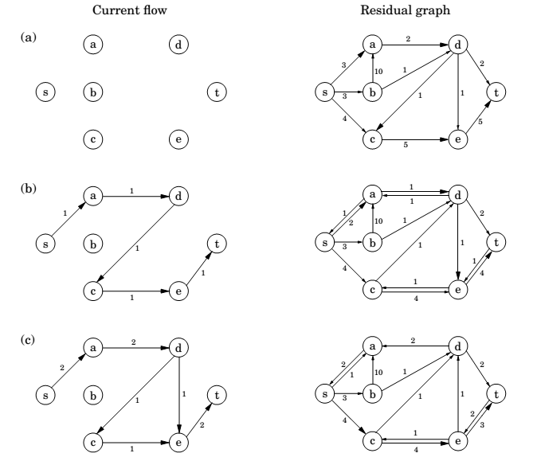

Slide 11
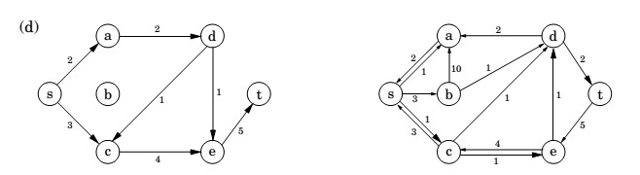
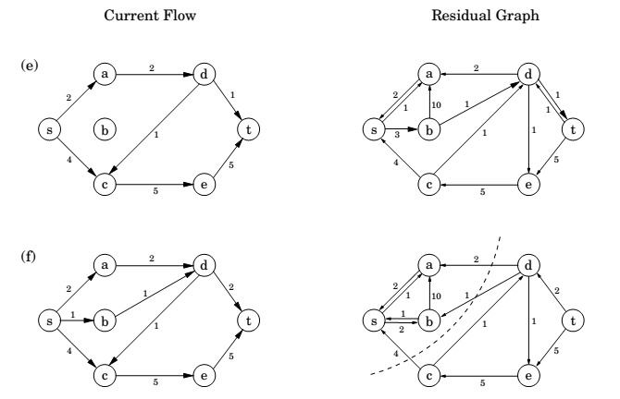

Slide 12
Cuts
A truly remarkable fact:
not only does simplex correctly compute a maximum flow, but it also generates a short proof of the optimality of this flow!不仅产生了最优解，同时产生了证明
An (s, t)-cut partitions the vertices into two disjoint groups L and R such that s ∈ L and t ∈ R . Its capacity可以通过的量 is the total capacity of the edges from L to R , and as argued previously, is an upper bound on any flow:
Pick any flow f and any (s, t)-cut (L, R ),
then size(f ) ≤ capacity(L, R ).

Slide 13
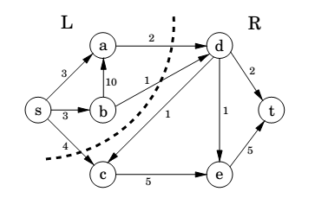
Cut

Slide 14
A certificate of optimality正确性证明
Theorem (Max-flow min-cut)
The size of the maximum flow in a network equals the capacity of the smallest (s, t)-cut.最大流=最小的分割，即size(f)<=capacity(L,R)
Proof.
Suppose f is the final flow when the algorithm terminates.
We know that node t is no longer reachable from s in the residual network G^{f} . Let L be the nodes that are reachable from s in G^{f} , and let R = V \ L be the rest of the nodes. We claim that
size(f ) = capacity(L, R )
To see this, observe that by the way L is defined, any edge going from L to R must be at full capacity (in the current flow f ), and any edge from R to L must have zero flow.
Therefore the net flow across (L, R ) is exactly the capacity of the cut.

Slide 15
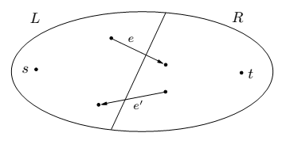
Max-flow min-cut

Slide 16
Efficiency时间复杂度
Each iteration of our maximum-flow algorithm is efficient, requiring O(|E |) time if a DFS or BFS is used to find an s -t path.
But how many iterations are there?
Suppose all edges in the original network have integer capacities ≤ C .
Then on each iteration of the algorithm, the flow is always an integer and increases by an integer amount. Therefore, since the maximum flow is at most C |E |, the number of iterations is at most this much.
If paths are chosen in a sensible manner – in particular, by using a BFS, which finds the path with the fewest edges – then the number of iterations is at most O(|V | · |E |), no matter what the capacities are.
This latter bound gives an overall running time of O(|V | · |E |²) for maximum flow.

Slide 17
Bipartite matching

Slide 18
The problem
A graph with nodes on the left representing boys and nodes on the right representing girls.
There is an edge between a boy and girl if they like each other.
Is it possible to choose couples so that everyone has exactly one partner, and it is someone they like?
In graph-theoretic jargon, is there a perfect matching?

Slide 19
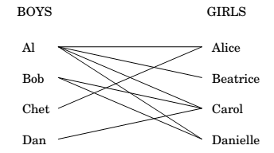
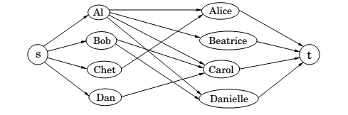
Bipartite matching

Slide 20
LP formulation
This matchmaking game can be reduced to the maximum-flow problem, and thereby to linear programming!
Create a new source node s with outgoing edges to all the boys;
a new sink node t, with incoming edges from all the girls;
and direct all the edges in the original bipartite graph from boy to girl.
Finally, give every edge a capacity of 1.

Slide 21
LP formulation
Then there is a perfect matching if and only if this network has a flow whose size equals the number of couples.
The maximum-flow problem has the following property: if all edge capacities are integers, then the optimal flow found by our algorithm is integral.
We can see this directly from the algorithm, which in such cases would increment the flow by an integer amount on each iteration.

Slide 22
Duality对偶性

Slide 23
Recall:
max x₁ + 6x₂
x₁ ≤ 200
x₂ ≤ 300
x₁ + x₂ ≤ 400
x₁ , x₂ ≥ 0
Simplex declares the optimum solution to be (x₁,x₂) = (100,300), with objective value 1900.
Can this answer be checked somehow?检验最优性
We take the first inequality and add it to six times the second inequality:
x₁ + 6x₂ ≤ 2000.
Multiplying the three inequalities by 0, 5, and 1, respectively, and adding them up yields
x₁ + 6x₂ ≤ 1900.

Slide 24
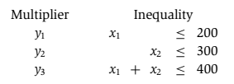
Let’s investigate the issue by describing what we expect of
these three multipliers, call them y_{1,} y₂ ,y₃.即前面的0、5、1
These y_{i}’s must be nonnegative, for otherwise they are unqualiﬁed to multiply inequalities. After the multiplication and addition steps, we get the bound:
(y₁ + y₃)x₁ + (y₂ + y₃)x₂ ≤ 200y₁ + 300y₂ + 400y_{3.}
We want the left-hand side to look like our objective function x₁ + 6x₂ so that the right-hand side is an upper bound上界 on the optimum solution.

Slide 25



We can easily find y’s that satisfy the inequalities on the right by simply making them large enough, for example
(y1, y2, y3) = (5, 3, 6). But these particular multipliers would tell us that the optimum solution of the LP is at most
200 · 5 + 300 · 3 + 400 · 6 = 4300,
a bound that is far too loose to be of interest.这个上界太松散了
What we want is a bound that is as tight as possible, so we should minimize 200y₁ + 300y₂ + 400y₃
subject to the preceding inequalities.
And this is a new linear program!

Slide 26
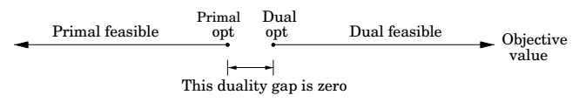
The dual program
min 200 y₁ + 300 y₂ + 400 y₃
y₁ + y₃ ≥ 1
y₂ + y₃ ≥ 6
y₁, y₂, y₃ ≥ 0
By design, any feasible value of this dual LP is an upper bound on the original primal LP. So if we somehow find a pair of primal and dual feasible values that are equal, then they must both be optimal. Here is just such a pair:
Primal: (x₁, x₂) = (100, 300);
Dual: (y₁, y₂, y₃ ) = (0, 5, 1).
They both have value 1900, and therefore they certify each other’s optimality.相互验证了最优性

Slide 27

A generic primal LP in matrix-vector form
and its dual
Primal LP: Dual LP:
max c^{T}x min y^{T}b
Ax $≤$ b y^{T} A $≥$ c^{T}
x $≥$ 0 y $≥0$
Theorem (Duality)
If a linear program has a bounded optimum, then so does its dual, and the two optimum values coincide.

Slide 28
Zero-sum games

Slide 29
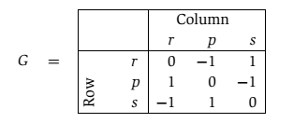
Rock-paper-scissors game石头剪刀布
We can represent various conflict situations in life by matrix
games.
The schoolyard rock-paper-scissors game is specified by the
payoﬀ matrix G: the Row player vs. the Column player

Slide 30
Mixed strategy
We play this game repeatedly.
If Row always makes the same move, Column will quickly catch on and will always play the countermove, winning every time. Therefore Row should mix things up: we can model this by allowing Row to have a mixed strategy, in which on each turn she plays r with probability x₁, p with probability x₂, and s with probability x₃.
This strategy is speciﬁed by the vector x = (x₁,x₂,x₃), positive numbers that add up to 1.
Similarly, Column’s mixed strategy is some y = (y₁,y₂,y₃).
i,j

Slide 31
Mixed strategy (cont.)
On any given round of the game, there is an x_{i}y_{j} chance that Row
and Column will play the ith and jth moves, respectively.
Therefore the expected (average) payoﬀ is
Row wants to maximize this, while Column wants to minimize it.

Slide 32


Completely random strategy
Suppose Row plays the “completely random” strategy
x = (1/3,1/3,1/3).
If Column plays r, then the average payoff will be
This is also true if Column plays p, or s.
And since the payoﬀ of any mixed strategy (y₁, y₂, y₃) is
just a weighted average of the individual payoffs for
playing r, p, and s, it must also be zero.

Slide 33
Completely random strategy (cont’d)
Thus by playing the “completely random” strategy, Row forces an expected payoﬀ of zero, no matter what Column does.
This means that Column cannot hope for a negative expected
payoff (remember that he wants the payoﬀ to be as small
as possible).
Symmetrically, if Column plays the completely random strategy, he also forces an expected payoff of zero, and thus Row cannot hope for a positive expected payoff.
The best each player can do is to play completely randomly, with an expected payoff of zero.

Slide 34
Two scenarios
1. First Row announces her strategy, and then Column picks his.
2. First Column announces his strategy, and then Row chooses hers.
We’ve seen that the average payoff is the same (zero) in either case if both parties play optimally.
But this might well be due to the high level of symmetry非常对称情况 in rock-paper-scissors.
In general games, we’d expect the first option to favor Column, since he knows Row’s strategy and can fully exploit it while choosing his own.

Slide 35
Two scenarios (cont.)
In general games, we’d expect the first option to favor Column, since he knows Row’s strategy and can fully exploit it while choosing his own.
Likewise, we’d expect the second option to favor Row.
Amazingly, this is not the case: if both play optimally, then it doesn’t hurt a player to announce his or her strategy in advance!
What’s more, this remarkable property is a consequence of and in fact –equivalent to – linear programming duality.和对偶性类似，一边最大化，一边最小化

Slide 36
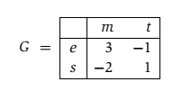
Presidential election总统选举
There are two candidates for office, and the moves they make correspond to campaign issues on which they can focus (the initials(首字母) stand for economy, society, morality, and tax cut).
The payoff entries of G are millions of votes lost by Column.

Slide 37
Pure strategy
Suppose Row announces that she will play the mixed strategy x = (1/2,1/2). What should Column do?
Move m will incur an expected loss of 1/2, while t will incur an expected loss of 0. The best response of Column is therefore the pure strategy y = (0,1).
More generally, once Row’s strategy x = (x₁, x₂) is fixed, there is always a pure strategy that is optimal for Column:
either move m, with payoﬀ 3x₁ − 2x₂, or t, with payoﬀ −x₁ + x₂, whichever is smaller.

Slide 38
Pure strategy (cont.)
Therefore, if Row is forced to announce x before Column plays, she knows that his best response will achieve an expected payoff of min{3x₁−2x₂, −x₁+x₂}.
She should choose x defensively to maximize her payoff against this best response:
Pick (x₁,x₂) that maximizes min{3x₁ − 2x₂, −x₁ + x₂}.

Slide 39
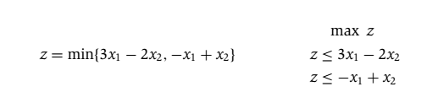
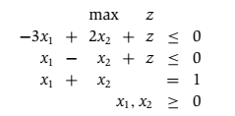
LP formulation
Row needs to choose x₁ and x₂ to maximize this z.

Slide 40
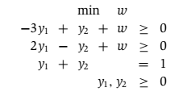
LP formulation (cont’d)
Symmetrically, if Column has to announce his strategy first, his best bet is to choose the mixed strategy y that minimizes his loss under Row’s best response:
Pick (y₁, y₂) that minimizes max{3y₁ − y₂, −2y₁ + y₂}.
In LP form:
These two LPs are dual to each other (see Figure 7.11)! Hence, they have the same optimum, call it V.

Slide 41
Value of the game
By solving an LP, Row (the maximizer) can determine a strategy for herself that guarantees an expected outcome of at least V no matter what Column does.
And by solving the dual LP, Column (the minimizer) can guarantee an expected outcome of at most V, no matter what Row does.
It follows that this is the uniquely defined optimal play: a priori it wasn’t even certain that such a play existed. V is known as the value of the game
In our example, it is 1/7 and is realized when Row plays her optimum mixed strategy (3/7,4/7) and Column plays his optimum mixed strategy (2/7,5/7).

Slide 42

Min-max theorem of games
This is surprising, because the left-hand side, in which Row has to announce her strategy first, should presumably be better for Column than the right-hand side, in which he has to go first.
Duality equalizes the two.

